Slide 1

SPOTIFY FEATURES ANALYSIS
BY NISHA MENON

Slide 2
Business Objective
To know about the attributes that affect the song’s popularity in Spotify.

Slide 3
Dataset
This dataset is taken from Kaggle.
The dataset consists of 232725 records across 18 fields.
The dataset includes genres, track names, track id, popularity, and features like energy, loudness, etc...

Slide 4

Research Questions
Are the popularity of pop songs and jazz songs the same?
How does energy affect the danceability of songs?
Is there any correlation between liveness and valence?
Does the loudness have an impact on the energy of the songs?
Does energy have an impact on the popularity of songs?

Slide 5
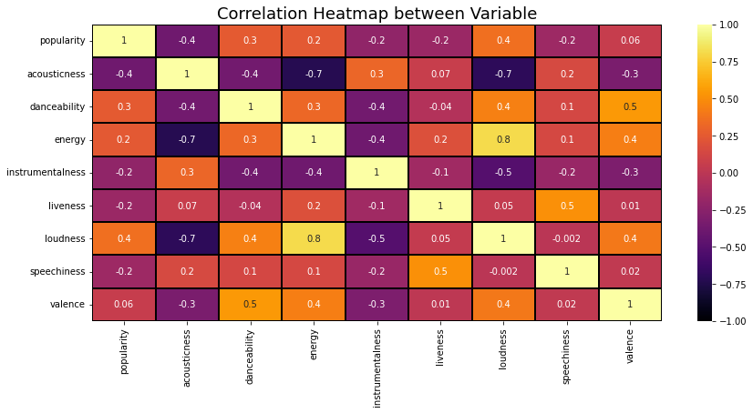
Correlation Heatmap
On the right side, we can see a scale ranging from -1 to +1. Here -1 denotes the variables that have the least or negative correlation, while the values above 0.0 denote the variables with a positive correlation.

Slide 6

Hypothesis 1: Popularity of Pop songs and Jazz Songs
Null Hypothesis: The popularity of pop and jazz songs is the same.
Alternate Hypothesis: The popularity of pop songs and jazz songs are not the same.
An independent 2 sample T-Test was conducted.
Statistics: 207.90
PValue = 0.0
P value < 0.05
Confidence interval: 26.01 – 25.52
The test confirmed a statistically significant difference in the mean popularity of pop and jazz songs.

Slide 7
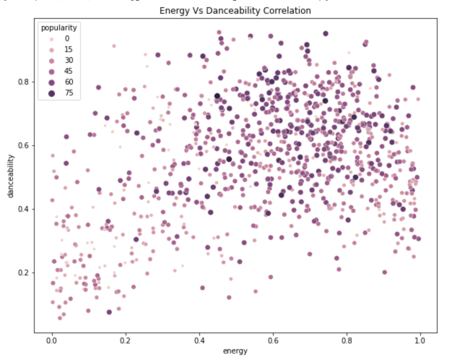
Hypothesis 2: Correlation between energy and danceability in songs
Pearsonr test and visualization were used to find the correlation.
Correlation Coefficient : 0.326
Correlation range : 0 - 1
The relationship is positive.
Most popular songs have high energy and danceability.

Slide 8
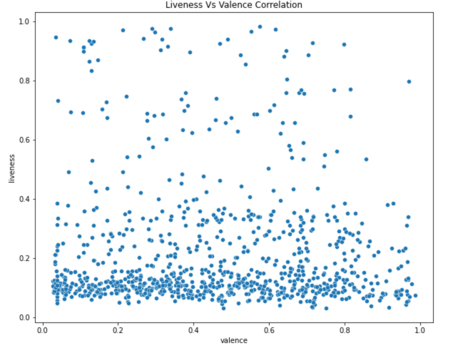
Hypothesis 3: Correlation between liveness and valence in songs.
Pearsonr test and visualization were used to find the correlation.
Correlation Coefficient : 0.011
Correlation range : 0 - 1
The relationship is positive
There doesn’t seem to be a strong linear relationship between liveness and valence in songs.

Slide 9
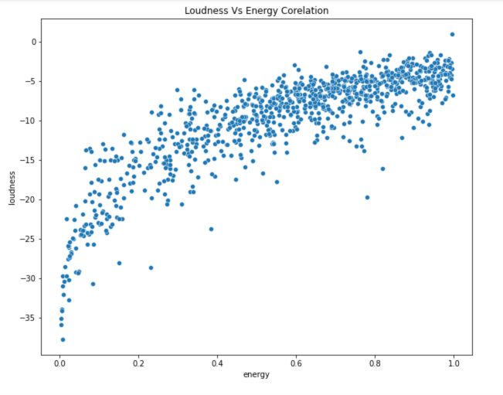
Hypothesis 4: Correlation between energy and loudness in songs.
Pearsonr test and visualization were used to find the correlation.
Correlation Coefficient : 0.816
Correlation range : 0 - 1
The relationship is positive
There is a strong positive correlation between loudness and energy in songs.

Slide 10
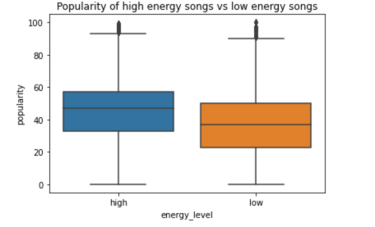
Hypothesis 5: Popularity of high energy songs vs low energy songs.
Null Hypothesis: The popularity of high-energy songs and low-energy songs are the same.
Alternate Hypothesis: The popularity of high-energy songs and low-energy songs are not same.
An independent 2 sample T-Test was conducted.
Statistics: 122.58
PValue = 0.0
Pvalue < 0.05
Confidence interval: 9.44 – 9.13
The test confirmed a statistically significant difference in the mean popularity of high-energy and low-energy songs.

Slide 11
Summary
Different genres of songs have different popularity.
There is a positive correlation between energy and danceability, liveness and valence, and energy and loudness in songs. We created interesting visualizations and extracted useful insights about the correlation between the variables in songs.
High-energy songs are more popular than low-energy songs.

Slide 12
Recommendations
Musicians should investigate more of the popular audio features while composing their songs.
Selecting a well-liked genre will help the music to be more popular.
The higher the popularity index, the more likely Spotify will recommend the song to the listeners.

Slide 13

THANK YOU

